Slide 1
Garden birds
A rough intro and tips for identification
By
Natalie West

Slide 2
Main RSPB big garden birdwatch species
Magpie
Woodpigeon
Collared dove
Blackbird
Song Thrush
Starling
Robin
Chaffinch
Goldfinch
Great Tit
Blue Tit
Coal Tit s
Long-tailed Tit
Greenfinch
House Sparrow
Dunnock
Wren
Blackcap

Slide 3
Magpie
44 to 46 cm
In the crow family
On their own or small group

Slide 4
Woodpigeon
Huge 40 to 42 cm
Not graceful
Will try and sit on branches/feeders they are clearly too big/heavy for
Usually on its own or in pairs

Slide 5
Collared Dove
31 to 33 cm
More graceful than the woodpigeon
Black collar
On its own or in pairs

Slide 6
Blackbird
Male
24 to 25 cm
Plump
Not all blackbirds are black!
Males – black with yellow beak
Females – brown, can have speckled breast
On the ground picking through leaves
Female

Slide 7
Song Thrush
23 cm
Buff coloured breast
Very speckled
Relatively short tail
Stands quite upright
On the ground, usually alone

Slide 8
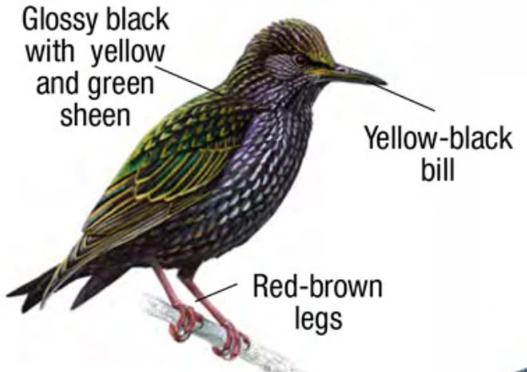
Starling
21.5 cm
Big pointy beak
Usually in groups
Love meal worms

Slide 9
Robin
14 cm
Usually on their own
Very friendly
Might be on feeders or the ground

Slide 10
Chaffinch
14.5 cm
Males – pinkish-brown breast
Females – yellowish brown
Distinctive white wing bars on both
Might be on the feeders or on the ground

Slide 11
Goldfinch
12 cm
Love nyger seeds
Red face
Gold in the wings
Often in a small group
Notes:
Thin beaks for tweezering seeds out of teasels
Group is called a charm

Slide 12
Great Tit
14 cm
Yellow breast
Black head
Significant size difference between Great Tit and Coal/Blue Tit.
Seen on seed feeders

Slide 13
Blue Tit
11.5 cm
Yellow breast
Very blue cap
Notes:
Great tits a bit like adults, blue tits like the kids in a group hopping about in the hedges

Slide 14
Coal Tit
11.5 cm
Black
White stripe at back of head

Slide 15
Long-tailed Tit
14 cm - 9 cm is tail
Fluffy with pinkish breast
Often fly through in a noisy mob
Regularly joined by other tits
Notes:
Undulating flight, like a tablespoon
Often see great tits/coal tits/blue tits tagging along

Slide 16
Greenfinch
15 cm
Heavy-looking conical bill
Green colour
Yellow patches in wings
Don’t see very many in Cambridge

Slide 17
House Sparrow
14 to 15 cm
LBJ
Males – grey head and black bib
Females – straw-coloured eye stripe
Thick bill
Feeds from and under seed feeders
Often in large flocks

Slide 18
Dunnock
14.5 cm
LBJ
Thin black bill
Blue-grey head and breast
Alone or in pairs
Under hedges

Slide 19
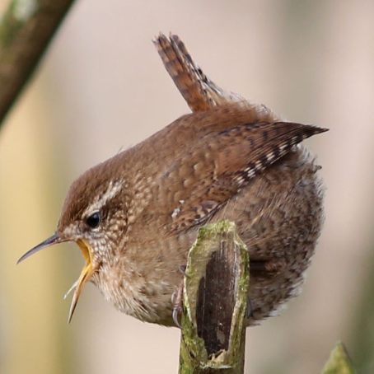
Wren
9 to 10 cm
Tiny
On the ground or low in hedges
Tail stands upright
© british-garden-birds.com

Slide 20
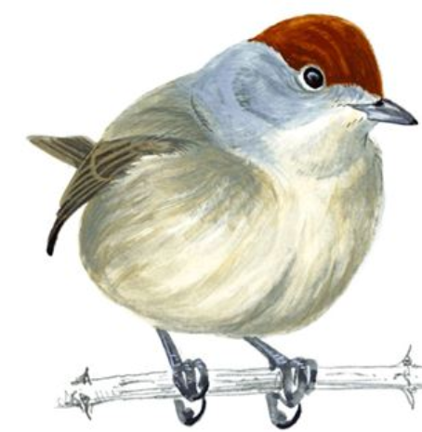
Blackcap
13 cm
Males – black cap
Females – brown cap
In hedges eating berries

Slide 21
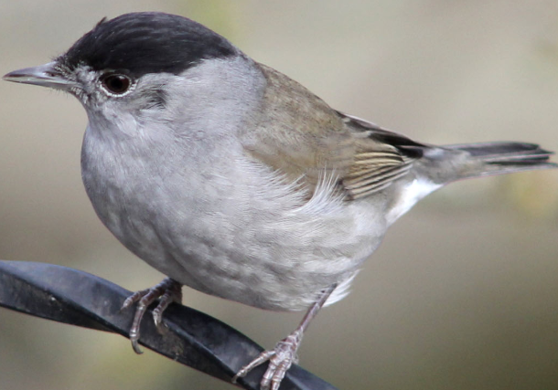
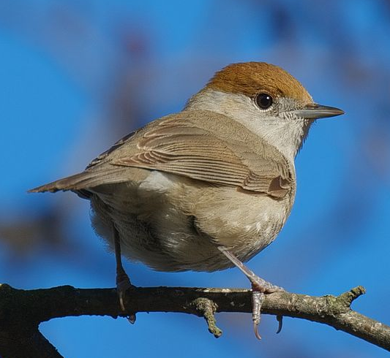
Blackcap
© british-garden-birds.com
© Stefan Berndtsson

Slide 22
Visit the RSPB website to sign up for the #BigGardenBirdwatch Happy birding!
© Natalie West
Credits: Images taken from RSPB except where otherwise credited

